Slide 1
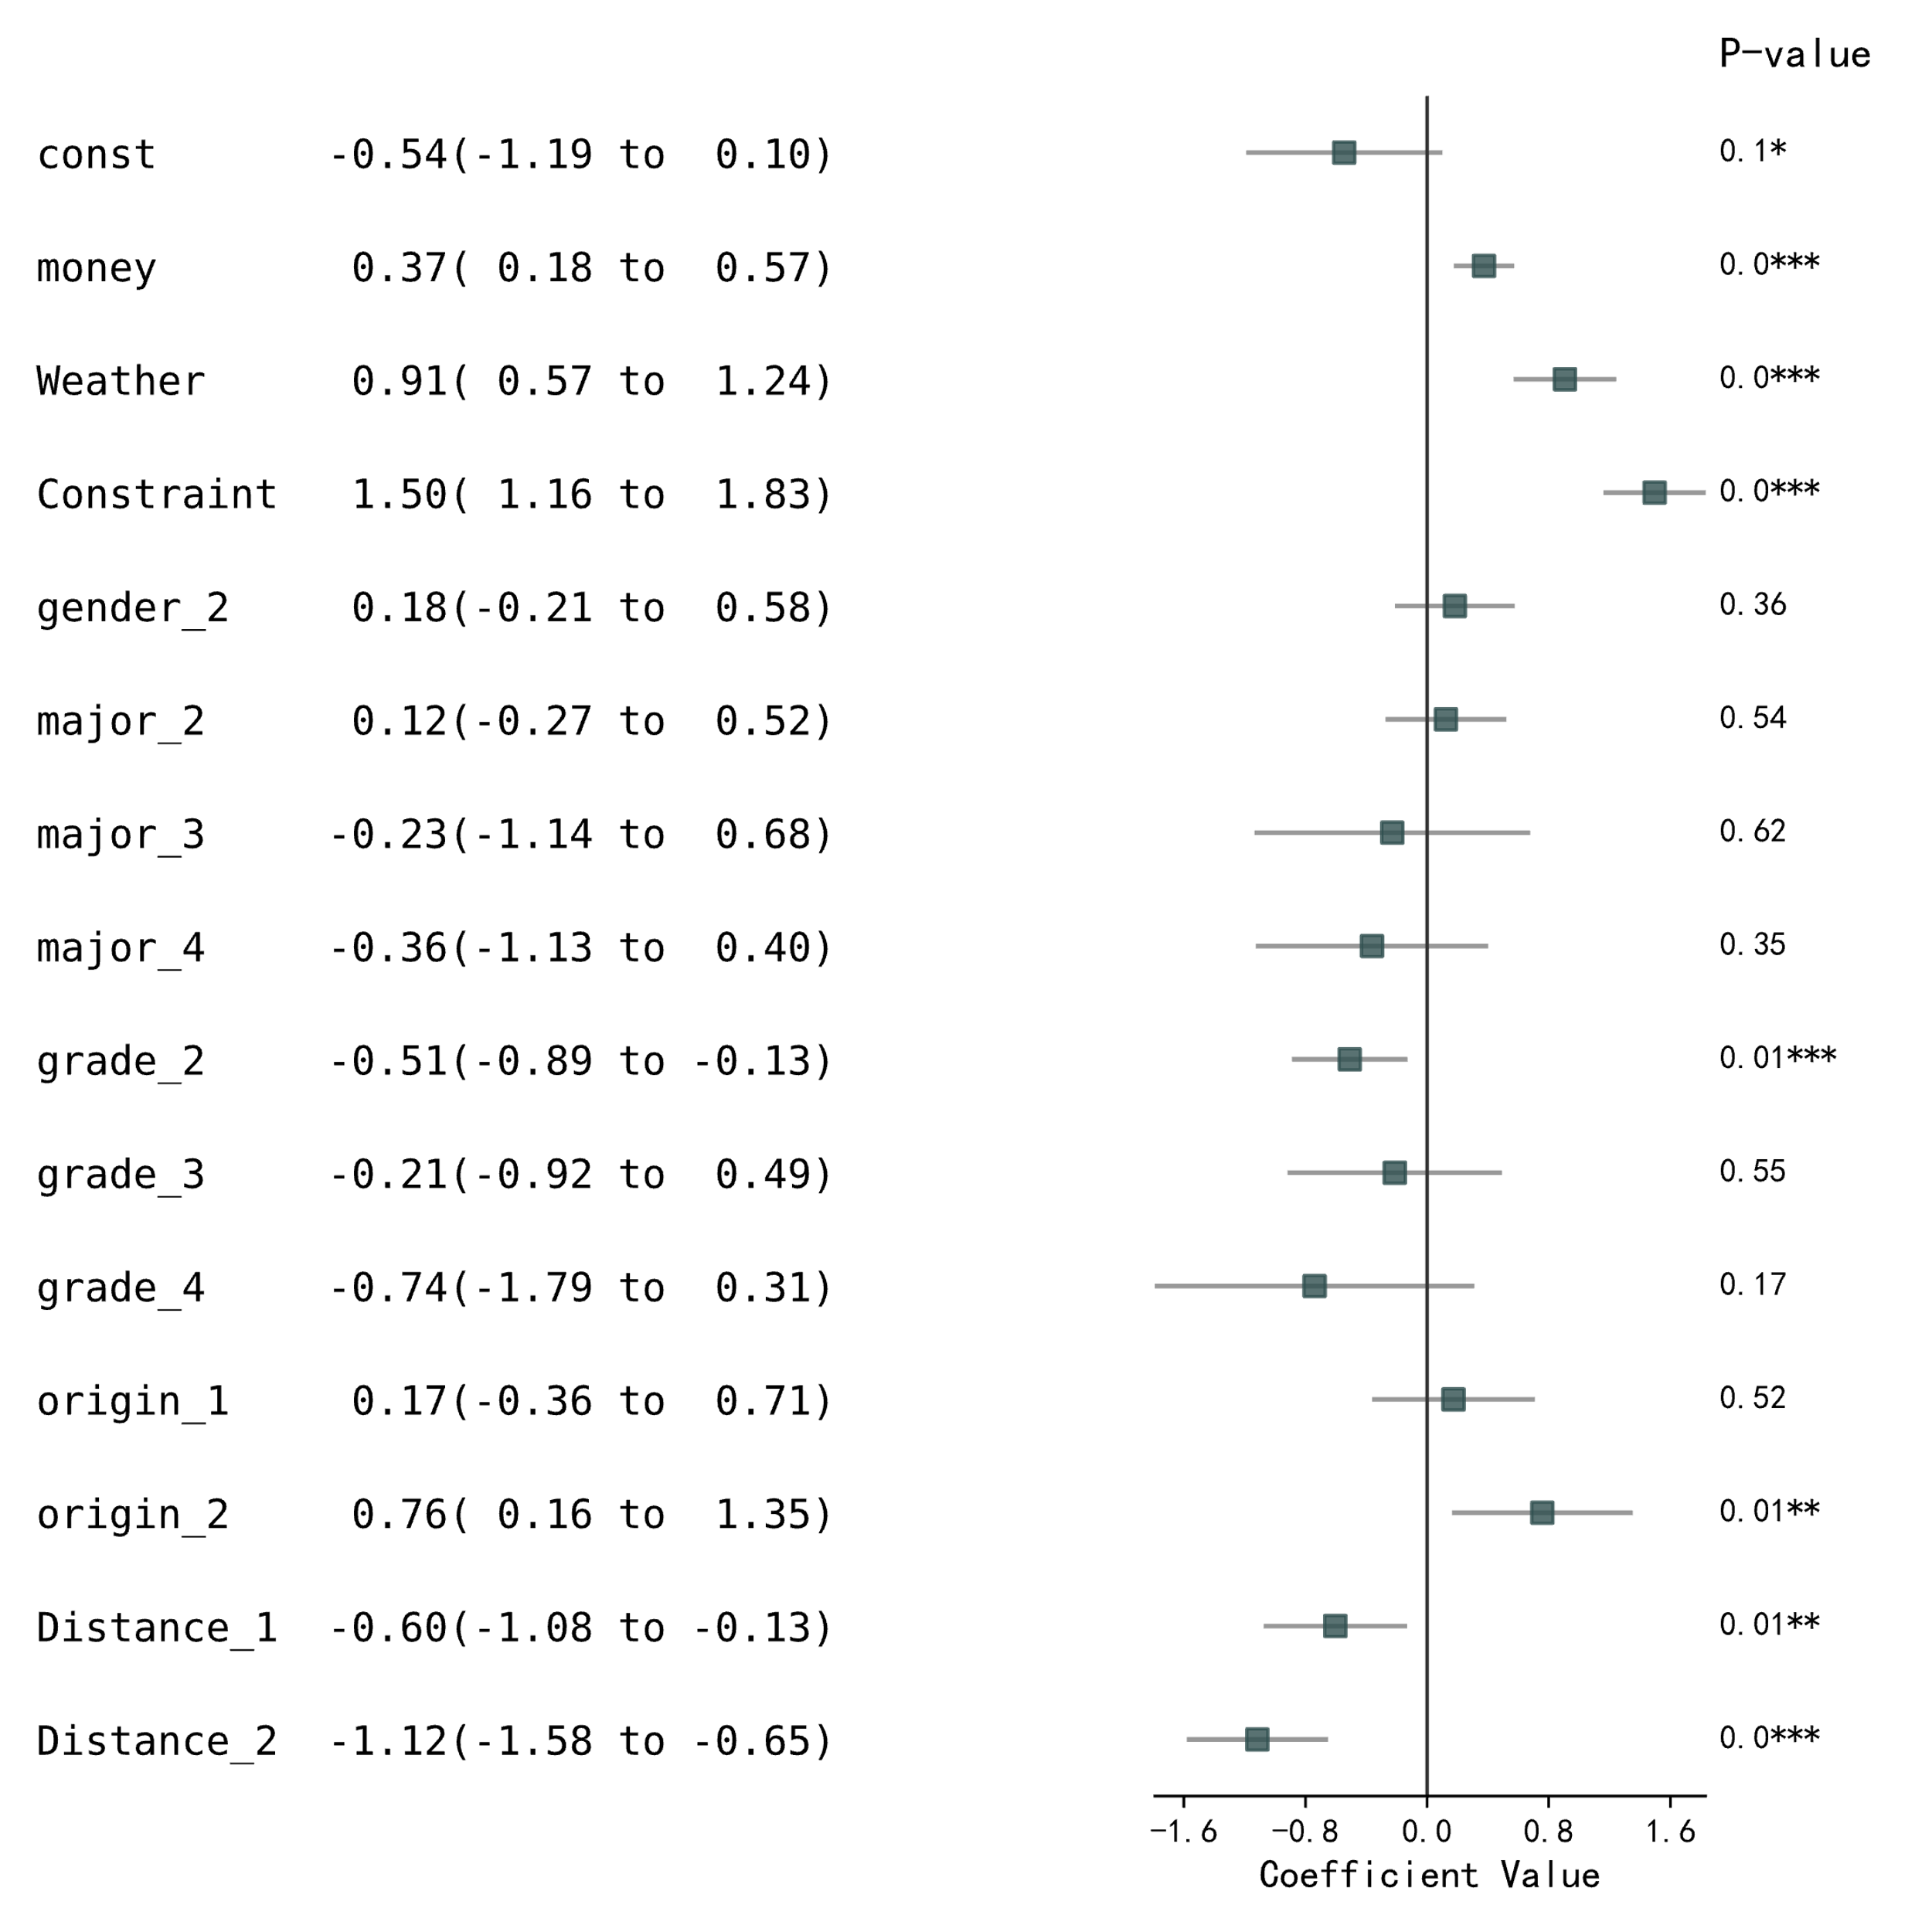
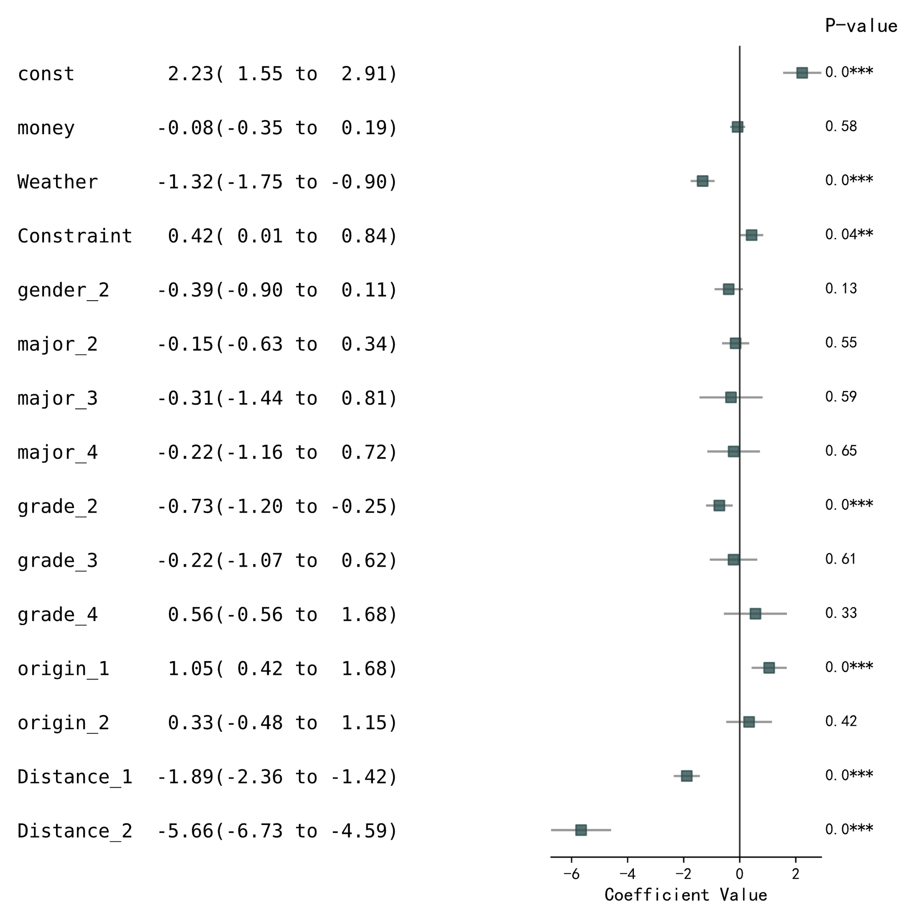
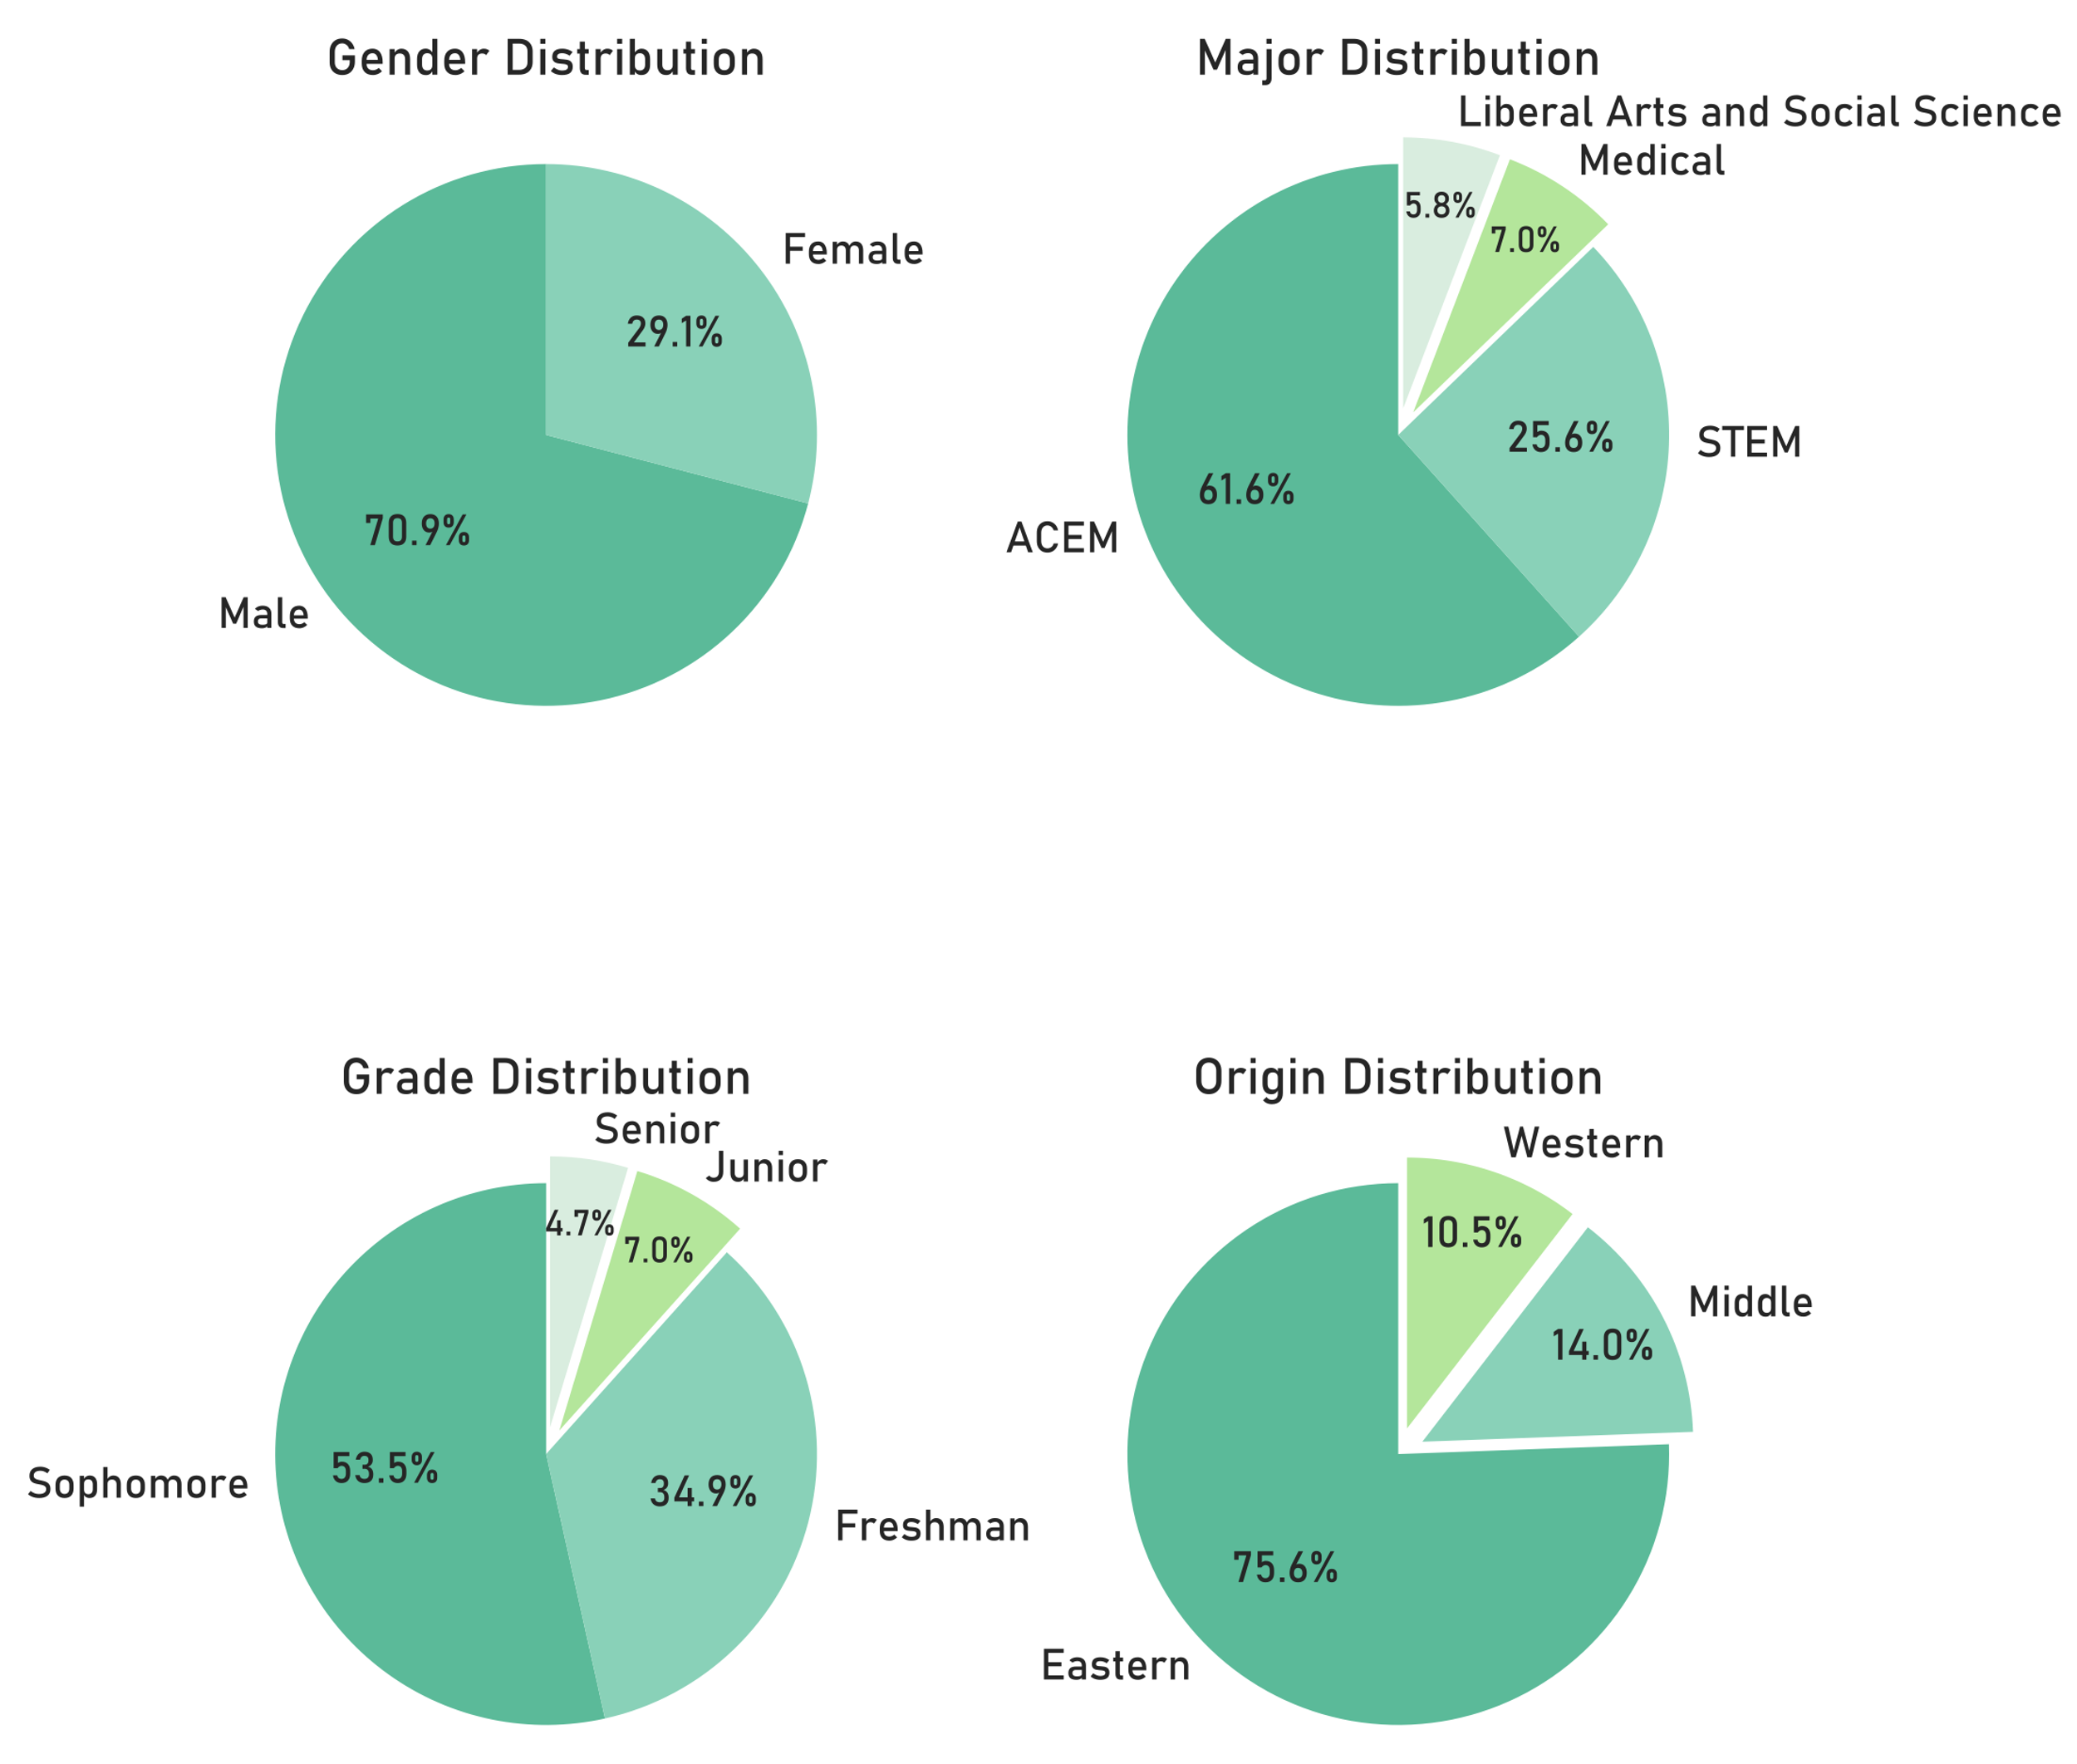
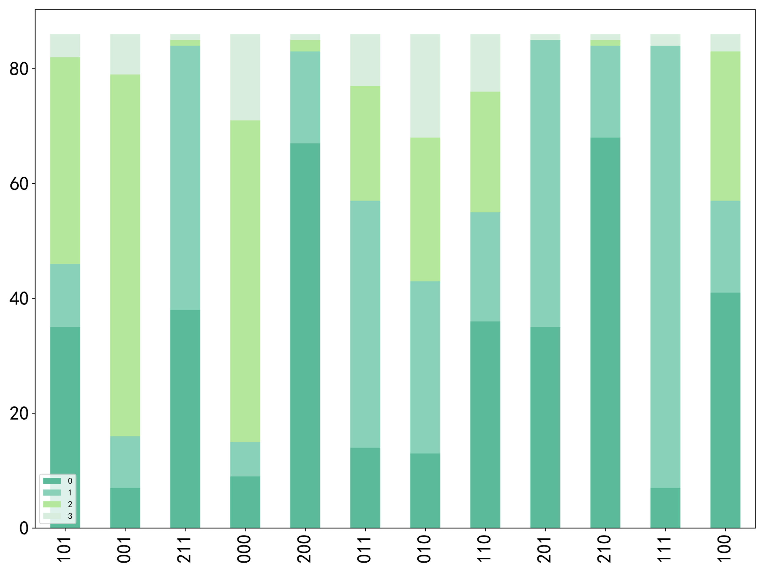
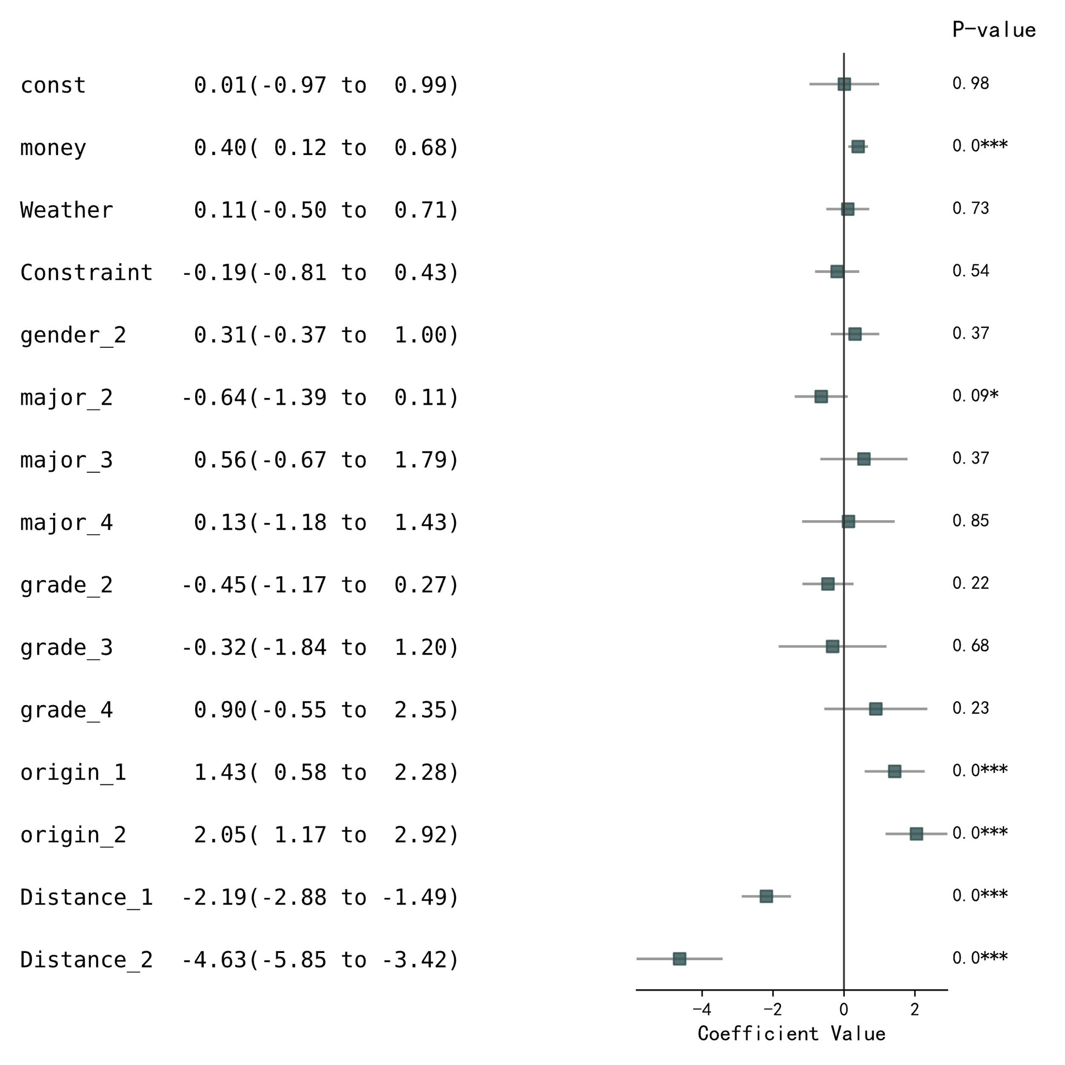
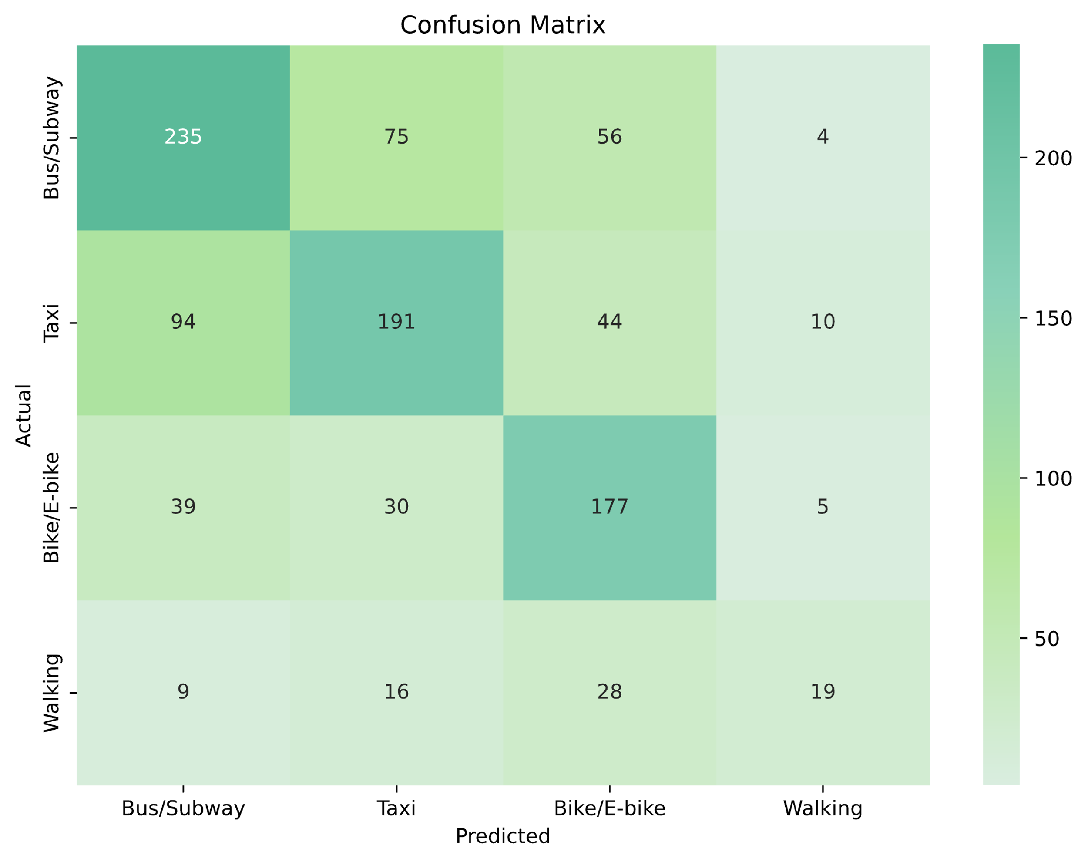
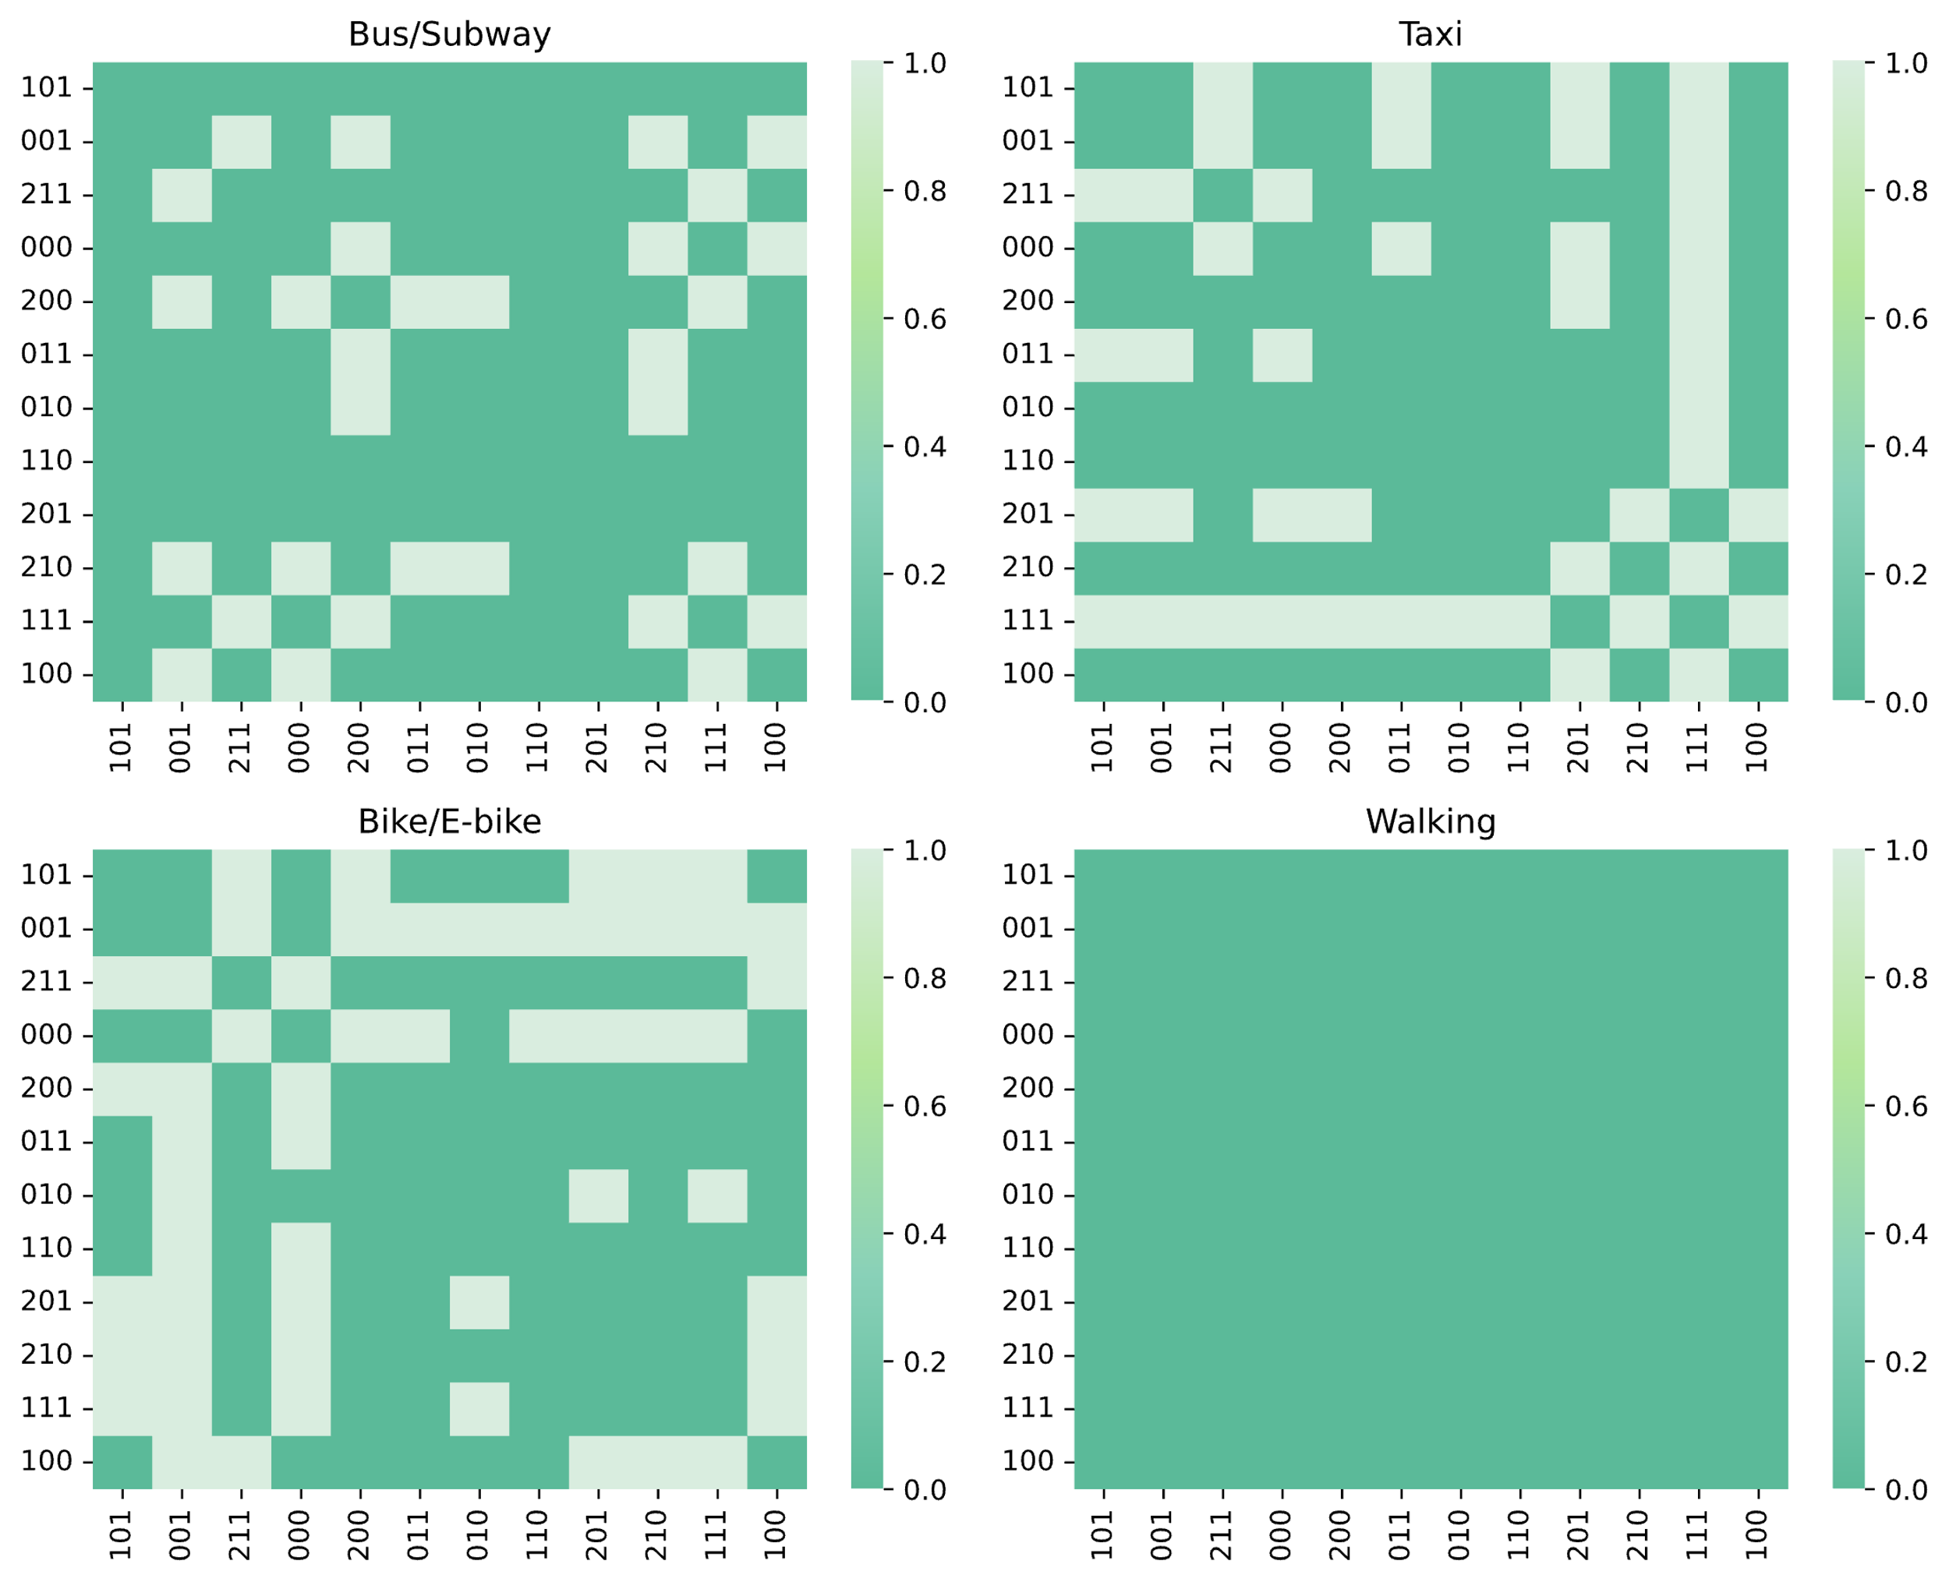
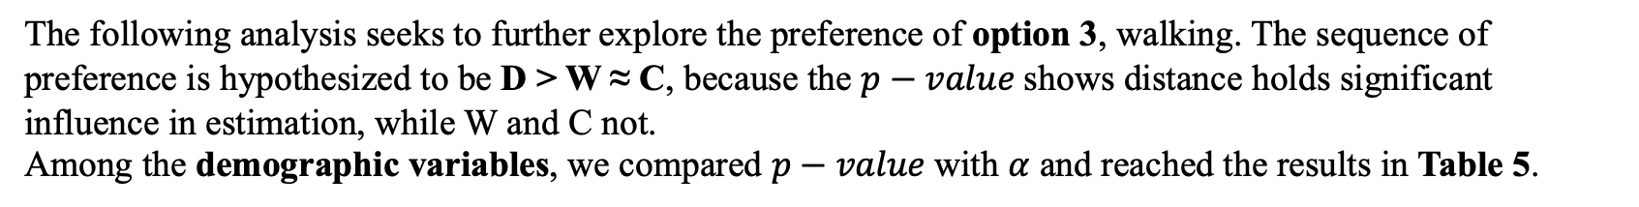
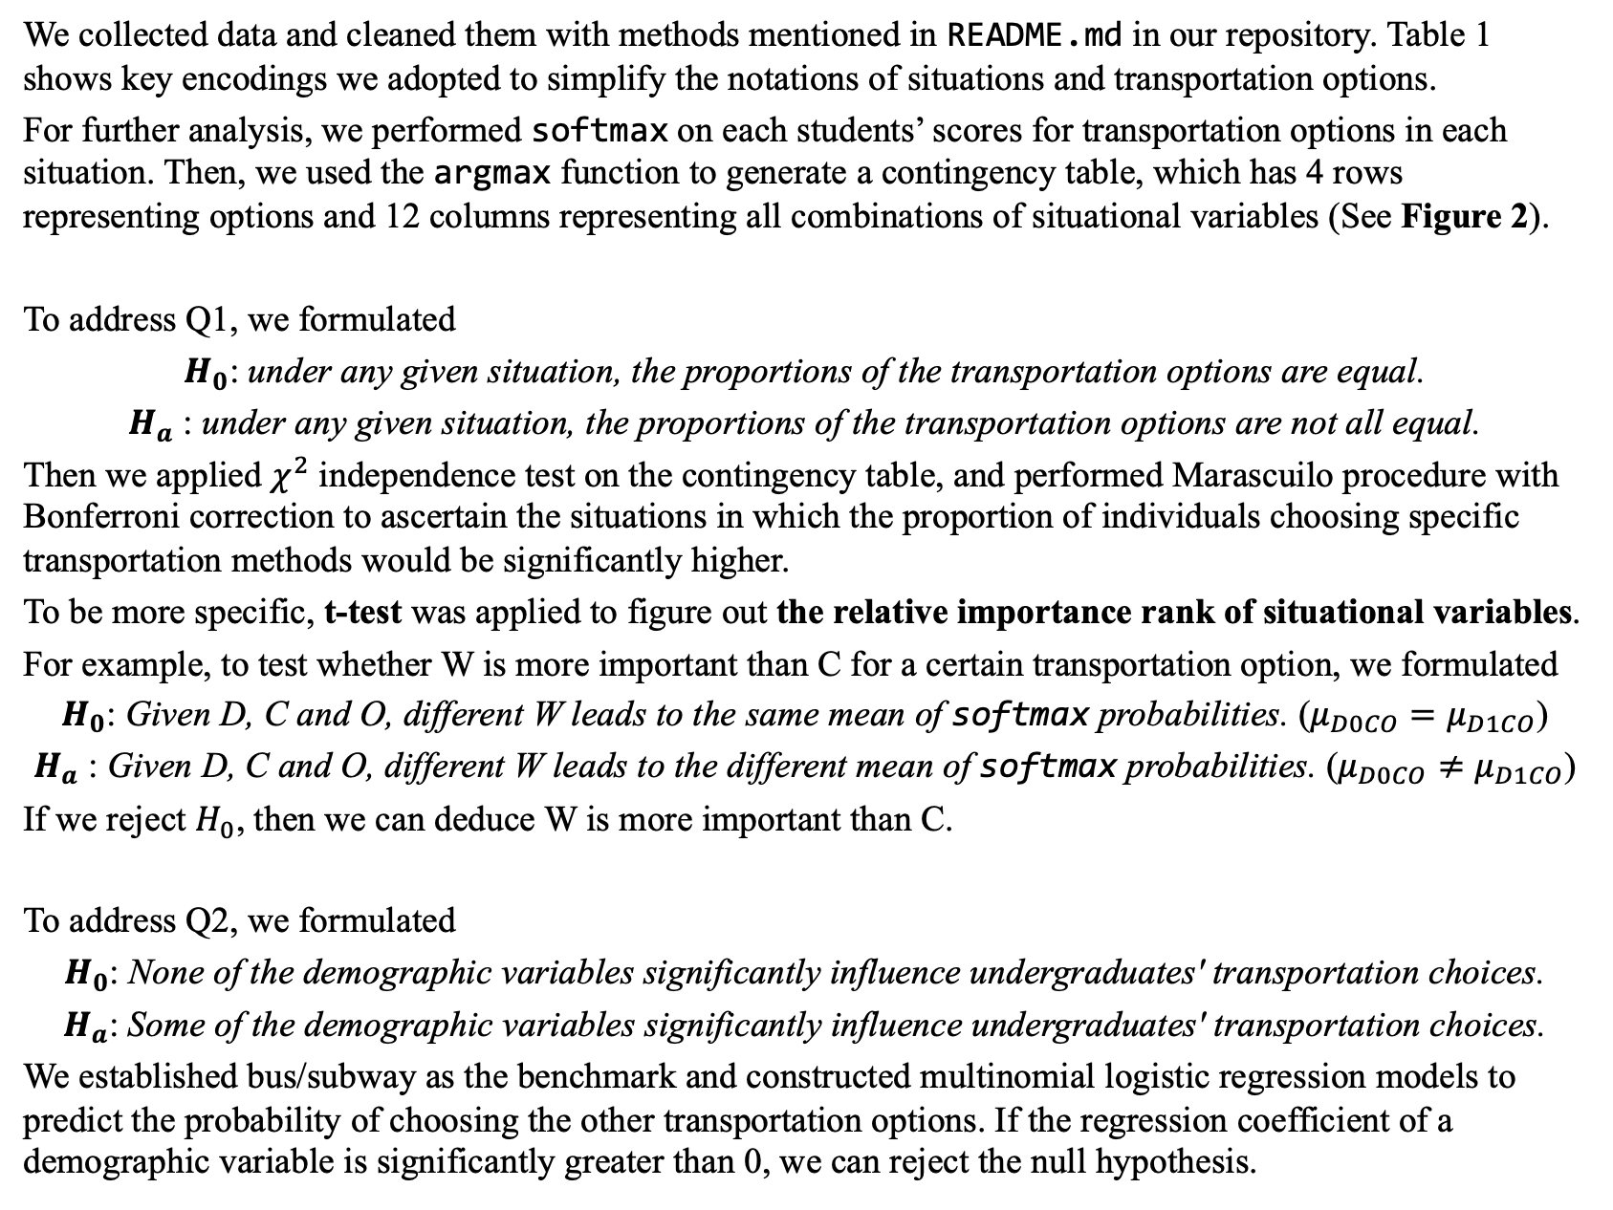
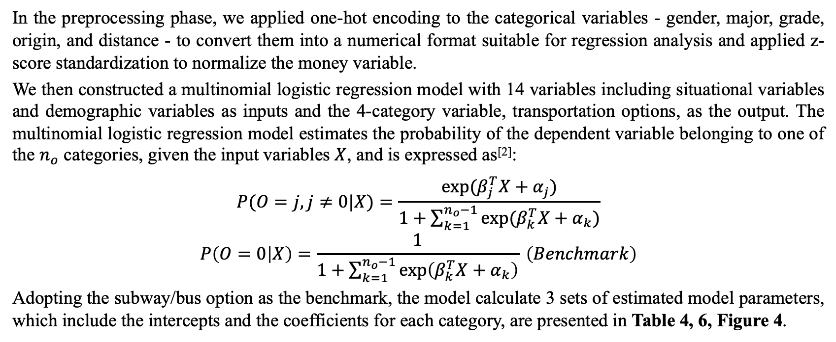
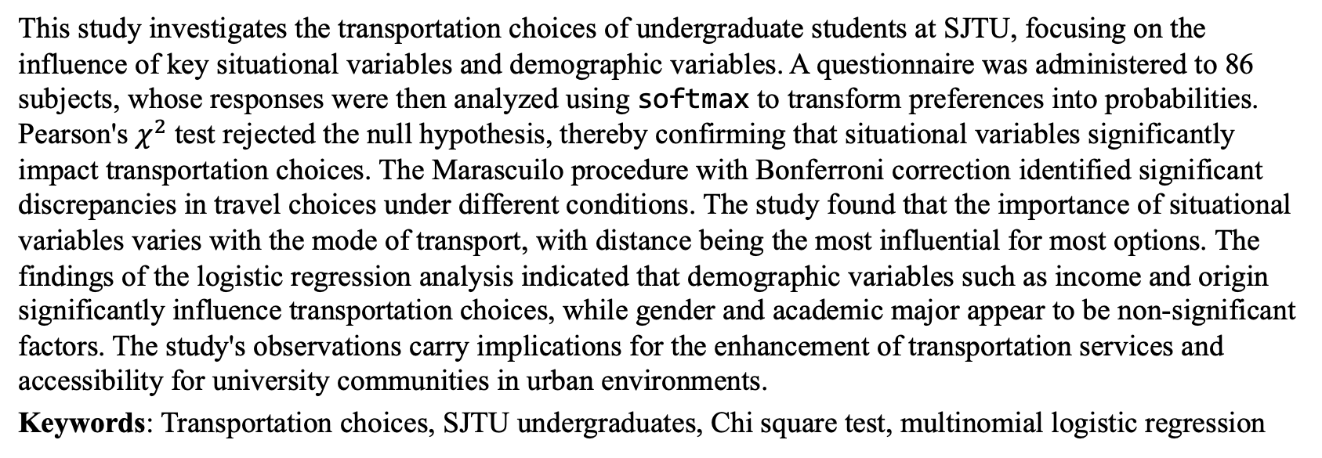
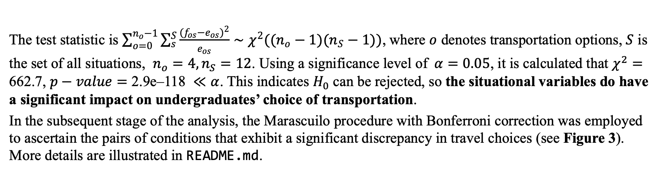
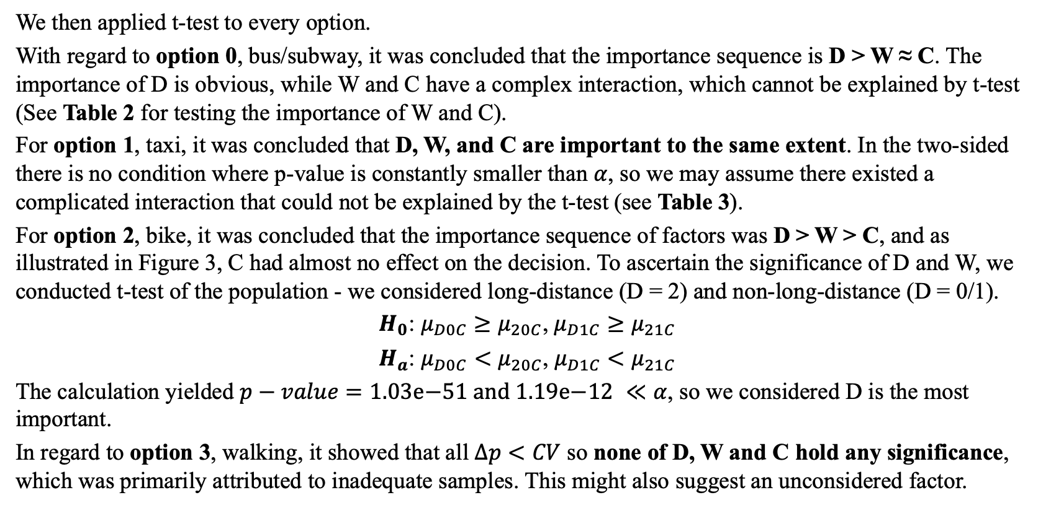
‘Jiao Tong’ Preference of Jiao Tong Undergraduates 施奕涵、吴泽楠、方真、高纵、亢予凡
Abstract
Results
We then applied t-test to every option.
With regard to option 0, bus/subway, it was concluded that the importance sequence is D > W ≈ C. The importance of D is obvious, while W and C have a complex interaction, which cannot be explained by t-test (See Table 2 for testing the importance of W and C).
For option 1, taxi, it was concluded that D, W, and C are important to the same extent. In the two-sided there is no condition where p-value is constantly smaller than $α$, so we may assume there existed a complicated interaction that could not be explained by the t-test (see Table 3).
For option 2, bike, it was concluded that the importance sequence of factors was D > W > C, and as illustrated in Figure 3, C had almost no effect on the decision. To ascertain the significance of D and W, we conducted t-test of the population - we considered long-distance (D = 2) and non-long-distance (D = 0/1).
$H_{0}$: $μ_{D0C}≥μ_{20C}$, $μ_{D1C}≥μ_{21C}$
$H_{a}$: $μ_{D0C}<μ_{20C}$, $μ_{D1C}<μ_{21C}$
The calculation yielded $p−value=\text{1.03}\text{e}\text{−51 }\text{and}\text{ 1.19}\text{e}\text{−12} ≪α$, so we considered D is the most important.
In regard to option 3, walking, it showed that all $Δp<CV$ so none of D, W and C hold any significance, which was primarily attributed to inadequate samples. This might also suggest an unconsidered factor.
Taxi
Bikes/e-bikes
This study investigates the transportation choices of undergraduate students at SJTU, focusing on the influence of key situational variables and demographic variables. A questionnaire was administered to 86 subjects, whose responses were then analyzed using softmax to transform preferences into probabilities. Pearson's $χ^{2}$ test rejected the null hypothesis, thereby confirming that situational variables significantly impact transportation choices. The Marascuilo procedure with Bonferroni correction identified significant discrepancies in travel choices under different conditions. The study found that the importance of situational variables varies with the mode of transport, with distance being the most influential for most options. The findings of the logistic regression analysis indicated that demographic variables such as income and origin significantly influence transportation choices, while gender and academic major appear to be non-significant factors. The study's observations carry implications for the enhancement of transportation services and accessibility for university communities in urban environments.
Keywords: Transportation choices, SJTU undergraduates, Chi square test, multinomial logistic regression
A total of 86 samples were collected, and no outliers were identified. Figure 1 shows basic information of demographic variables with pie charts.
Table 1: Key encodings
Variables | Description
Distance (D) | 0/1/2 - short/medium/long-distance
Weather (W) | 0/1 - sunny/rainy
Time Constraint (C) | 0/1 - time-abundant/constrained
Option (O) | 0 - subway/bus, 1 - taxi, 2 - bikes/e-bikes, 3 - walking.
Objectives
Walking
The primary research questions guiding this study are as follows:
To what extent do key situational variables – namely, the distance of the trip(D), weather conditions(W), and time constraints(C) – affect travel decisions? Furthermore, the study sought to identify the single most critical factor among these situational variables that predominantly drive transportation preferences. It is important to note that in this question we will not consider individual characteristics of the students.
Whether demographic variables such as gender, origin, major, and income play a significant role in shaping these decisions.
Hopefully we may answer more questions. Are there any interactions among all the independent variables mentioned above? Can we build a simple model to predict students' decisions under different circumstances?
Table 2
Table 3
 | D 0 | D 1 | D 2
W 0 for C | 0.30 | 0.01 | 0.28
W 1 for C | 0.16 | 4.04e-11 | 0.98
C 0 for W | 0.01 | 0.53 | 0.61
C 1 for W | 1.31e-9 | 4.83e-37 | 0.64
 | D 0 | D 1 | D 2
W 0 | 5.95e-5 | 0.76 | 0.67
W 1 | 8.68e-9 | 4.65e-38 | 0.98
C 0 | 0.41 | 0.22 | 4.93e-6
C 1 | 0.01 | 1.61e-27 | 7.20e-8
Figure 1: Demographic variables
Figure 2: Plotted contingency table
Q1
The test statistic is $\sum_{o=0}^{n_{o}−1}{\sum_{s}^{S}{\frac{(f_{os}−e_{os})^{2}}{e_{os}}}}∼χ^{2}((n_{o}−1)(n_{S}−1))$, where $o$ denotes transportation options, $S$ is the set of all situations, $n_{o}=4, n_{S}=12$. Using a significance level of$α=0.05$, it is calculated that $χ^{2}=$ 662.7, $p−value=\text{2.9}\text{e}\text{–118} ≪α$. This indicates $H_{0}$ can be rejected, so the situational variables do have a significant impact on undergraduates’ choice of transportation.
In the subsequent stage of the analysis, the Marascuilo procedure with Bonferroni correction was employed to ascertain the pairs of conditions that exhibit a significant discrepancy in travel choices (see Figure 3). More details are illustrated in README.md.
Methods
Q2
We collected data and cleaned them with methods mentioned in README.md in our repository. Table 1 shows key encodings we adopted to simplify the notations of situations and transportation options.
For further analysis, we performed softmax on each students’ scores for transportation options in each situation. Then, we used the argmax function to generate a contingency table, which has 4 rows representing options and 12 columns representing all combinations of situational variables (See Figure 2).
To address Q1, we formulated
$H_{0}$: under any given situation, the proportions of the transportation options are equal.
$H_{a}$ : under any given situation, the proportions of the transportation options are not all equal.
Then we applied $χ^{2}$ independence test on the contingency table, and performed Marascuilo procedure with Bonferroni correction to ascertain the situations in which the proportion of individuals choosing specific transportation methods would be significantly higher.
To be more specific, t-test was applied to figure out the relative importance rank of situational variables.
For example, to test whether W is more important than C for a certain transportation option, we formulated
$H_{0}$: Given D, C and O, different W leads to the same mean of softmax probabilities. ($μ_{D0CO}=μ_{D1CO}$)
$H_{a}$ : Given D, C and O, different W leads to the different mean of softmax probabilities. ($μ_{D0CO}≠μ_{D1CO}$)
If we reject $H_{0}$, then we can deduce W is more important than C.
To address Q2, we formulated
$H_{0}$: None of the demographic variables significantly influence undergraduates' transportation choices.
$H_{a}$: Some of the demographic variables significantly influence undergraduates' transportation choices.
We established bus/subway as the benchmark and constructed multinomial logistic regression models to predict the probability of choosing the other transportation options. If the regression coefficient of a demographic variable is significantly greater than 0, we can reject the null hypothesis.
In the preprocessing phase, we applied one-hot encoding to the categorical variables - gender, major, grade, origin, and distance - to convert them into a numerical format suitable for regression analysis and applied z-score standardization to normalize the money variable.
We then constructed a multinomial logistic regression model with 14 variables including situational variables and demographic variables as inputs and the 4-category variable, transportation options, as the output. The multinomial logistic regression model estimates the probability of the dependent variable belonging to one of the $n_{o}$ categories, given the input variables $X$, and is expressed as^{[2]}:​
$$P(O=j, j≠0|X)=\frac{exp(β_{j}^{T}X+α_{j})}{1+\sum_{k=1}^{n_{o}−1}{exp(β_{k}^{T}X+α_{k})}}$$
$$P\left(O=0 | X\right)=\frac{1}{1+\sum_{k=1}^{n_{o}−1}{\exp\left(β_{k}^{T}X+α_{k}\right)}} \left(Benchmark\right)$$
Adopting the subway/bus option as the benchmark, the model calculate 3 sets of estimated model parameters, which include the intercepts and the coefficients for each category, are presented in Table 4, 6, Figure 4.
Figure 4: Forest plots for regression coefficients and the confusion matrix
Delving into the p-values of all coefficients, we discovered that gender and major have no significant effect in transportation choice, while whether an undergraduate is in their second year contributes to estimating the transportation choice. Pocket money plays a role in estimating one's choice of taxi or walking, which is understandable in that the former is relatively expensive and the latter is much cheaper. Lastly, the region of origin is quite important in estimating all of the choices.
Conclusion
For bus/subway, D is the most important. W and C have a complex interaction.
For taxi, D, W and C are equally important and might have a complex interaction.
For bike/e-bike, D is the most important, W is the second and C is almost irrelevant.
For walking, D is the most important, which needs further research due to insufficient data or an unexpected variable.
Neither Gender nor Major significantly influenced these decisions.
Whether one is second-year in Grade were found to be influential.
Income was identified as crucial in choices between taxis and walking.
Origin was also key in the estimation of all transportation choices.
The following analysis seeks to further explore the preference of option 3, walking. The sequence of preference is hypothesized to be D > W ≈ C, because the $p−value$shows distance holds significant influence in estimation, while W and C not.
Among the demographic variables, we compared $p−value$with $α$ and reached the results in Table 5.
Table 4
Table 5
 | Precision | Recall | F1
Bus/Subway | 0.62 | 0.64 | 0.63
Taxi | 0.61 | 0.56 | 0.59
Bike/E-bike | 0.58 | 0.71 | 0.64
Walking | 0.50 | 0.26 | 0.35
Variables | Influence level (to option)
Gender | No
Major | No
Grade (Sophomore) | Great to all
Pocket money | Great to option 1 and 3
Origin | Great to all
Codes and References
https://github.com/Github-1069/Jiaotong-Preference
[1] Statistics for Business and Economics, 13e, by Anderson, Sweeney, Williams, Camm, and Cochran (2018)
[2] https://en.wikipedia.org/wiki/Multinomial_logistic_regression
[3] https://en.wikipedia.org/wiki/Pseudo-R-squared
Figure 3: Heatmaps of Multiple Comparison Results
Cox and Snell^{[3]} R² = 0.2776

